Slide 1

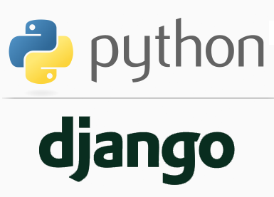
FULL STACK WEB DEVELOPMENT WITH DJANGO
Lecture 16

Slide 2

Today’s Agenda
Developing Our Django App
Template Inheritance
Example

Slide 3
Template Inheritance
So far we have been creating very simple templates but in the real world, this is rarely the case.
To give a common look and feel across all the pages of a website some HTML code is repeated.
Typically header, navigation, footer, and sidebar remains the same throughout the site.
The problem arises when we want to modify some part of the page.
To better understand the issue, let’s take an example.

Slide 4
Template Inheritance
Recall that we developed a project with two apps called courses and trainers.
Each of these apps had two template based html pages named:
fontendcourses.html
backendcourses.html
frontendtrainers.html
backendtrainers.html
Now suppose we want to add a menu bar and footer in each of these pages as shown in the next slides

Slide 5
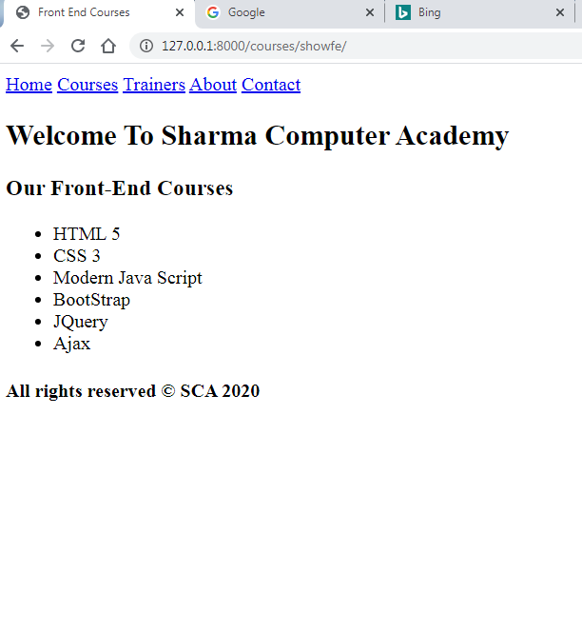
Desired Output

Slide 6
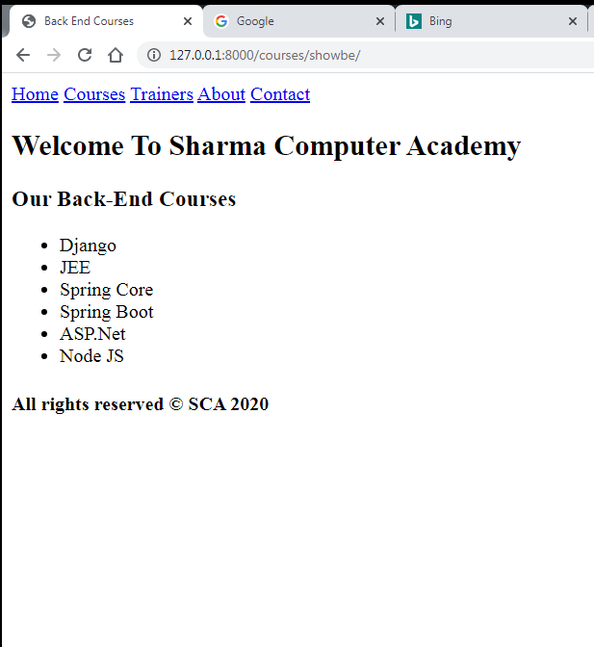
Desired Output

Slide 7
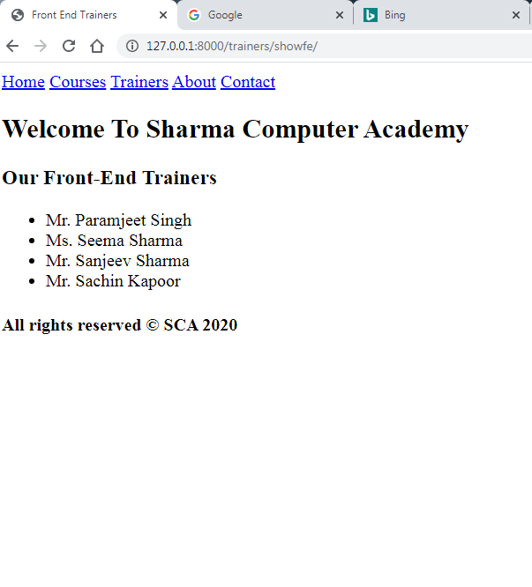
Desired Output

Slide 8
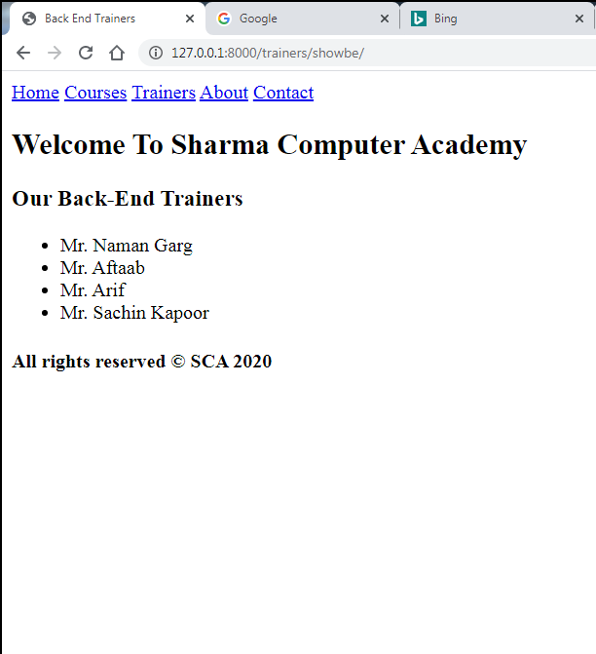
Desired Output

Slide 9
Template Inheritance
One way to achieve this would be to write the code for menu bar and footer in each of the 4 pages.
But this approach has two drawbacks:
Code redundancy
Difficulty to incorporate future changes
So an optimized solution to this problem is Template Inheritance.

Slide 10
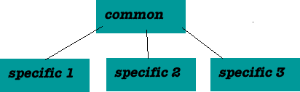
Template Inheritance
Template engines provide code reuse through inheritance, which is also a key concept in object-oriented programming.
With web page inheritance, we abstract the parts common to all web pages in one place, and let each specific page refer to these common parts.

Slide 11
How Template Inheritance Is Done ?
To use Template Inheritance we must follow three major steps as mentioned below:
Create a base template
Inside the base template define areas called blocks where content can be inserted by other template pages.
Create child templates which inherit the base template which replace the content inside the block with their own content

Slide 12
How To Create Base Template ?
A base template is just a simple skeleton that we will use as a base for all other pages on our site.
A base template defines areas where content can be inserted into.
In Django, we define this area using the block tag.

Slide 13
How To Create Base Template ?
The block tags have a very simple syntax which is :
{% block <block_name> %} <some content> {% endblock <block_name> %}
Where:
<block_name> is any name we want to give to the block
<some_content> is the default content we want to set for the block , if needed. This can be overridden by the child templates

Slide 14
What Is Child Template ?
A template which uses base.html as it’s base or more formally speaking a child template is a template which extends the base template.
This is done by writing the tag extends followed by the name of base template file .

Slide 15
How To Create Child Template ?
For ex: {% extends “base.html" %}
This tells Django template engine that the current template is a child template and inherits from base.html.
However a point to remember is that this must be the first line in the child template otherwise it won’t work.

Slide 16
How To Create Child Template ?
A child template can override, add or leave alone the contents of the parent block.
To override the default content of parent block in the child block we place the content in the child block between the tags {% block block_name %} and {% endblock block_name %}, where block_name is the name of the block whose content is to be overridden from the child template

Slide 17
Exercise
Using template inheritance modify the courses and trainers app templates so that they now have a common menu bar and footer

Slide 18
Solution
Following will be the steps to create the app :
Activating Django Environment in VS Code
Creating a Django Project in VS Code
Creating the apps
Activating the apps
Create the app level templates directory structure.
Creating the base template inside the main app of the project
Creating child templates in specific apps by inheriting the base template
Creating the view to render the template
Configuring the View in app level urls.py
Configuring urls in the project
Running the server
Opening the page in browser

Slide 19
What Is Main App ?
It is a very common approach in Django to create an app which will serve as the main /home app for our project.
We then write all the common pages like home page , about us page , contact page as well as base templates in this main app .
Popularly we call this app as mainsite or core

Slide 20
Performing Steps 1 To 5
Activate the virtual environment in VS CODE
Create a django project called demoproject12 by using the command:
django-admin startproject demiproject12
This will create the outer project folder called demoproject12and inner app folder also by the same name

Slide 21
Performing Steps 1 To 5
Now go to the outer project folder demoproject12 and create three apps called mainsite,courses and trainers by using the command:
django-admin startapp mainsite
django-admin startapp courses
django-admin startapp trainers
Now create a folder called templates in each of these apps and within templates create sub folder by the name of the app
Finally update settings.py so that it contains the name of all three apps

Slide 22
Performing Steps 1 To 5
Code:
INSTALLED_APPS = [
'django.contrib.admin',
'django.contrib.auth',
'django.contrib.contenttypes',
'django.contrib.sessions',
'django.contrib.messages',
'django.contrib.staticfiles',
‘mainsite',
‘courses’,
‘trainers’,]

Slide 23
Performing Steps 1 To 5
Make sure that uptill now your project and app folders look as shown on the next slide

Slide 24
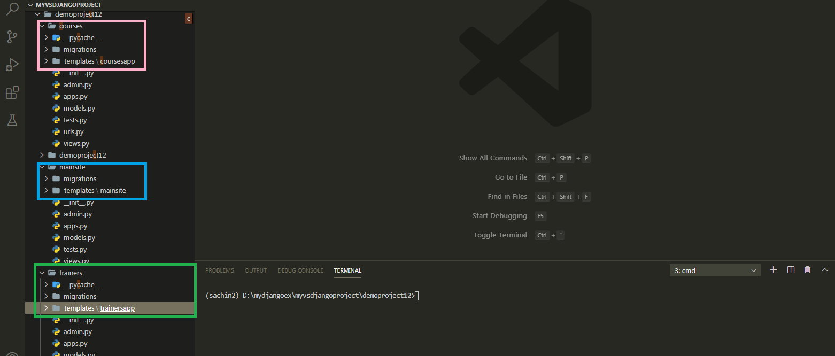
Performing Steps 1 To 5

Slide 25
Step 6: Creating The Base Template
Create a new file named base.html inside the templates→mainsite folder
Now add the code shown in next slide into it

Slide 26
Step 6: Creating The Base Template
<!DOCTYPE html>
<html lang="en">
<head>
<meta charset="UTF-8">
<meta name="viewport" content="width=device-width, initial-scale=1.0">
<title>{% block title %}{% endblock title %}</title>
</head>
<body>
<nav>
<a href="#">Home</a>
<a href="#">Courses</a>
<a href="#">Trainers</a>
<a href="#">About</a>
<a href="#">Contact</a>
</nav>
<h2> Welcome To Sharma Computer Academy</h2>
<h3>{% block ptitle %}{% endblock ptitle %}</h3>
<ul>{% block listitems %}{% endblock listitems %}</ul>
<h4>{% block footer %}All rights reserved &copy; SCA 2020{% endblock footer %}</h4>
</body>
</html>

Slide 27
Code Explained
This is our base template.
Here we are using a new template tag called block.
The block tag accepts a single argument, called block_name to specify the name of the block.

Slide 28
Code Explained
Here we have created four blocks namely title, ptitle , listitems and footer
The block tag defines a block that can be overridden by the child templates.

Slide 29
Step 7: Creating Child Templates
To use our base template we first have to create a child template.
As usual create 4 html files , 2 each inside the templates→courses and templates→trainers folders by the names :
fontendcourses.html
backendcourses.html
frontendtrainers.html
backendtrainers.html
Then add the code shown in next slide.

Slide 30
backendcourses.html
{% extends ’mainsite/base.html' %}
{% block title %}Back End Courses{% endblock title %}
{% block ptitle %}Our Back-End Courses{% endblock ptitle%}
{% block listitems%}
<li>Django</li>
<li>JEE</li>
<li>Spring Core</li>
<li>Spring Boot</li>
<li>ASP.Net</li>
<li>Node JS</li>
{% endblock listitems %}

Slide 31
frontendcourses.html
{% extends ’mainsite/base.html' %}
{% block title %}Front End Courses{% endblock title %}
{% block ptitle %}Our Front-End Courses{% endblock ptitle%}
{% block listitems%}
<li>HTML 5</li>
<li>CSS 3</li>
<li>Modern Java Script</li>
<li>BootStrap</li>
<li>JQuery</li>
<li>Ajax</li>
{% endblock listitems %}

Slide 32
backendtrainers.html
{% extends ’mainsite/base.html' %}
{% block title %}Back End Trainers{% endblock title %}
{% block ptitle %} Our Back-End Trainers{% endblock ptitle%}
{% block listitems%}
<li>Mr. Naman Garg</li>
<li>Mr. Aftaab</li>
<li>Mr. Arif</li>
<li>Mr. Sachin Kapoor</li>
{% endblock listitems %}

Slide 33
frontendtrainers.html
{% extends ’mainsite/base.html' %}
{% block title %}Front End Trainers{% endblock title %}
{% block ptitle %} Our Front-End Trainers{% endblock ptitle%}
{% block listitems%}
<li>Mr. Paramjeet Singh</li>
<li>Ms. Seema Sharma</li>
<li>Mr. Sanjeev Sharma</li>
<li>Mr. Sachin Kapoor</li>
{% endblock listitems %}

Slide 34
Code Explained
The first line , {% extends “mainsite/base.html" %} tells Django template engine that the current template is a child template and inherits from base.html.
This must be the first line in the child template otherwise it won’t work.

Slide 35
Code Explained
When template engine encounters this line it immediately loads the parent template (i.e base.html) and then replaces the blocks of content in parent template with the blocks of content of the same name defined in the child template.
If a block of matching name is not found in the child template then the content from the parent template is used.

Slide 36
Code Explained
Closely observe that in our child template we are not overriding footer block, so the default content from parent template will be used while rendering the child template.

Slide 37
Performing Steps 8 to 10
Finally to make this application functional we need to add code to views.py and both the ursl.py file as before
So we need to perform final 2 steps:
Creating the view to render the template
Configuring the View in Url

Slide 38
Step 8- Creating The View
Open the views.py file in the courses folder and write the following code which calls the template file and returns it to Django
views.py
from django.shortcuts import render
def showFrontEnd(request):
return render(request,'courses/frontendcourses.html')
def showBackEnd(request):
return render(request,'courses/backendcourses.html')

Slide 39
Step 8- Creating The View
Open the views.py file in the trainers folder and write the following code which calls the template file and returns it to Django
views.py
from django.shortcuts import render
def showFrontEnd(request):
return render(request,’trainers/frontendreainers.html')
def showBackEnd(request):
return render(request,‘trainers/backendtrainers.html')

Slide 40
Step 9- Configuring The View In Url
After creating and updating the views.py as shown in the previous slide we perform the next usual step which is configuring the urls
As usual we do this by configuring our URLs at 2 places:
Inside the app directory’s urls.py file
Inside the site’s main urls.py

Slide 41
Step 9- Configuring The View In Url
In the VS Code create a new file called urls.py in both the apps i.e courses and trainers and write the following code in it.
Code (courses/urls.py):
from django.urls import path
from . import views
urlpatterns = [
path('showfe/', views.showFrontEnd),
path('showbe/', views.showBackEnd),
]
Code (trainers/urls.py):
from django.urls import path
from . import views
urlpatterns = [
path('showfe/', views.showFrontEnd),
path('showbe/', views.showBackEnd),
]

Slide 42
Step 10- Configuring The View In Url
In the VS Code open the file called urls.py in the demoproject12 folder and update the code in it as shown below :
Code (demoproject12/urls.py):
from django.contrib import admin
from django.urls import path,include
urlpatterns = [
path('admin/', admin.site.urls),
path('courses/', include('courses.urls')),
path('trainers/',include('trainers.urls')),
]

Slide 43
Final Output

Slide 44
Final Output

Slide 45
Final Output

Slide 46
Final Output

Slide 47
Exercise
Develop a Django project having 3 html pages called home.html , showdatetime.html and contact.html.
Use template inheritance to generate the output as shown in the next slides

Slide 48
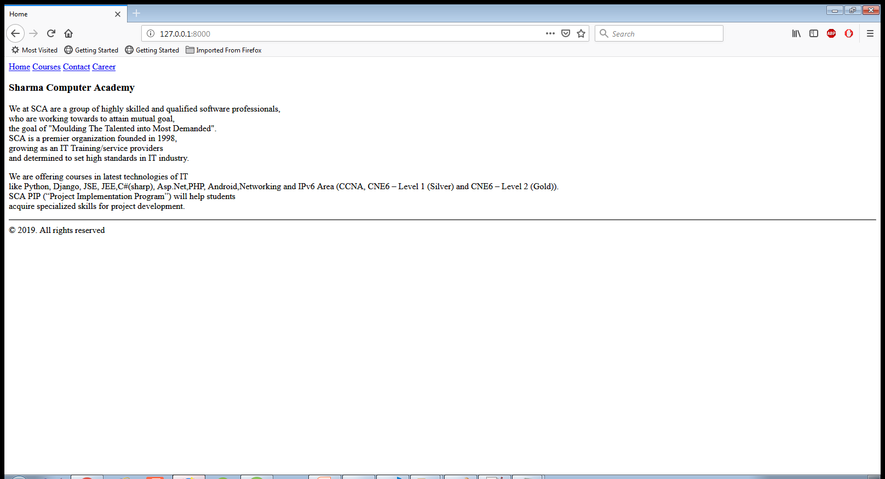
Output

Slide 49
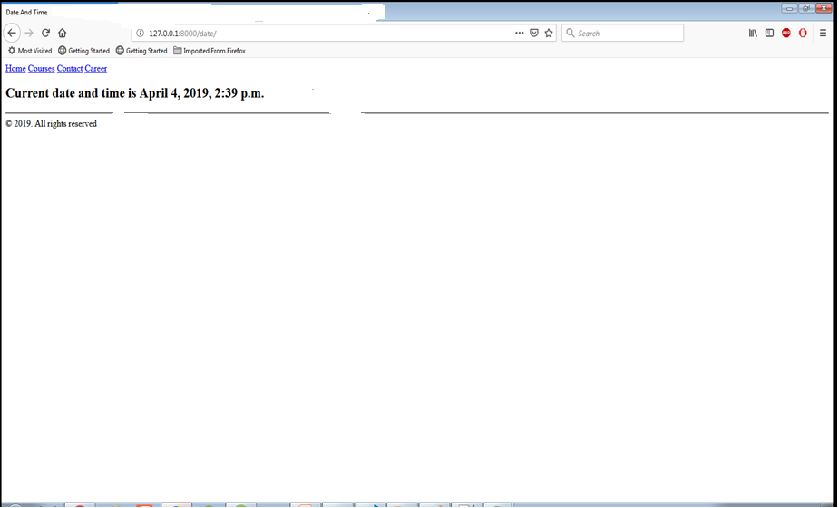
Output

Slide 50
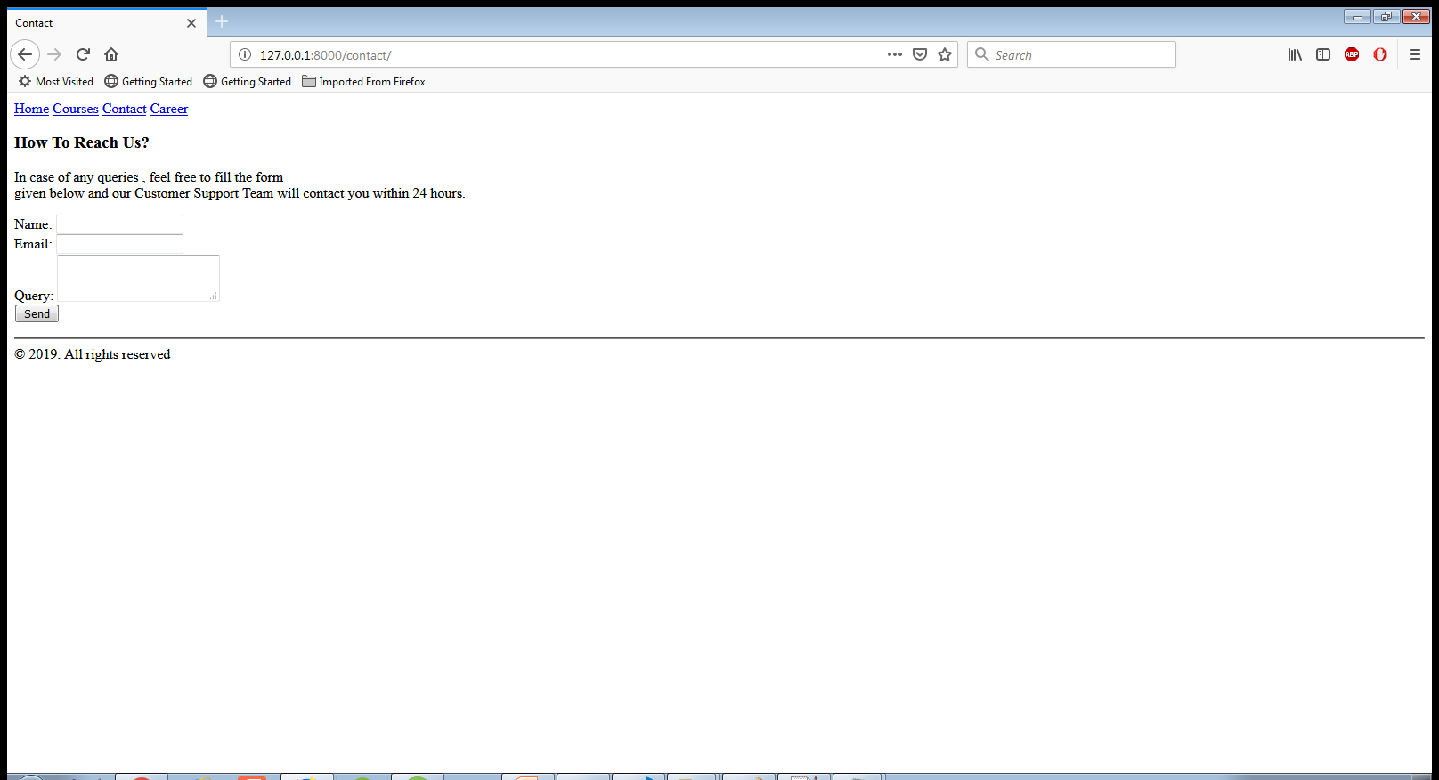
Output

